Slide 1


Presentation on
Strategic Management and Project Selection
2011049 – Anabil Dey
2011050 – Shadman Nahiyan
2011051 – Farin Nowshin
2011052 – Saiful Islam Nadim
2011053 - Md. Atik Faisal
2011054 - Jihan Mahbub Khan

Slide 2
1. Two new Internet site projects are proposed to a young start-up company. Project A will cost $250,000 to implement and is expected to have annual net cash flows of $75,000. Project B will cost $150,000 to implement and should generate annual net cash flows of $52,000. The company is very concerned about their cash flow. Using the payback period, which project is better, from a cash flow standpoint?
Answer:
1) Project A: Payback Period = $250,000/$75,000 = 3.3 years.
2) Project B: Payback Period = $150,000/$52,000 = 2.9 years
Project B is better because it has a shorter payback period.

Slide 3
2. Sean, a new graduate at a telecommunications fi rm, faces the following problem his first day at the fi rm: What is the average rate of return for a project that costs $200,000 to implement and has an average annual profit of $30,000?
Answer:
Payback period = $200,000 / $30,000 = 6.7 years
Average rate of return = $30,000 / $200,000 = 15%

Slide 4
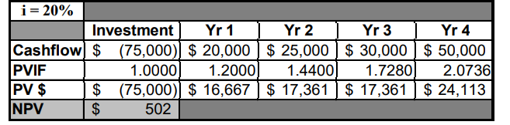
3. A four-year financial project has net cash flows of $20,000; $25,000; $30,000; and $50,000 in the next four years. It will cost $75,000 to implement the project. If the required rate of return is 0.2, conduct a discounted cash flow calculation to determine the NPV.
Answer:

Slide 5
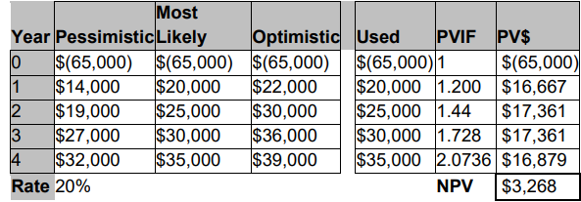
4. A four-year financial project has estimates of net cash flows shown in the following table: Year Pessimistic Most Likely Optimistic 1 $14,000 $20,000 $22,000 2 19,000 25,000 30,000 3 27,000 30,000 36,000 4 32,000 35,000 39,000 It will cost $65,000 to implement the project, all of which must be invested at the beginning of the project. After the fourth year, the project will have no residual value. Using the most likely estimates of cash flows, conduct a discounted cash flow calculation assuming a 20 percent hurdle rate with no inflation. (You may use either Excel® or a paper-and-pencil calculation.) What is the discounted profitability index of the project?
Answer:

Slide 6
The column labelled “Used” indicates the cash flow value used to calculate the net present value.
The profitability index is the sum of the discounted cash flows divided by the initial investment.
For this problem it is the sum of the PV’s for years 1-4 divided by $65,000
or:
68,268/65,000 = 1.05
Since the value is greater than one, the project should be accepted (assuming everything else is equal).

Slide 7
5. Nina is trying to decide in which of four shopping centres to locate her new boutique. Some locations attract a higher class of clientele than others, some are in an indoor mall, some have a much greater customer traffic volume than others, and, of course, rent varies considerably from one location to another. Because of the nature of her store, she has decided that the class of clientele is the most important consideration, the higher the better. Following this, however, she must pay attention to her expenses and rent is a major item, probably 90 percent as important as clientele. An indoor, temperature-controlled mall is a big help, however, for stores such as hers where 70 percent of sales are from passer-by slowly strolling and window shopping. Thus, she rates this as about 95 percent as important as rent. Last, a higher traffic volume of shoppers means more potential sales; she thus rates this factor as 80 percent as important as rent. As an aid in visualizing her location alternatives, she has constructed the following table. A “good” is scored as 3, “fair” as 2, and “poor” as 1. Use a weighted score model to help Nina come to a decision.

Slide 8
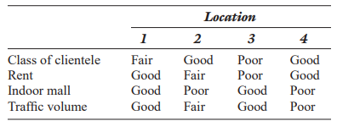
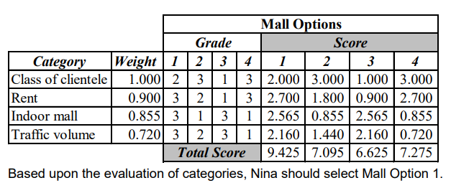
Answer:

Slide 9
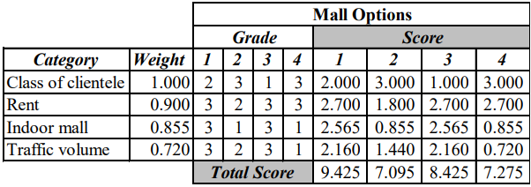
6. Referring to previous problem, develop a spreadsheet to help Nina select a location for her boutique. Suppose Nina is able to negotiate a lower rent at location 3 and thus raise its ranking to “good.” How does this affect the overall rankings of the four locations?
Answer:
Changing the grade for Location 3’s rent to '3':
Due to the rent change, Location 3 moves up from last place to second place based upon the grades assigned to the evaluated categories.

Slide 10
Thank You

